Slide 1
EagleSat 2 – Mission and Development Overview
Presented by: Hilliard Paige – Project Manager
In cooperation with: Dr. Gary Yale, Lauren Barthenheier, and Jason Hamburger
26th Arizona Space Grant Symposium
Tempe, Arizona
April 22nd 2017

Slide 2
Outline
Mission Overview
Concept of Operations
Purpose and Benefits
Development Progress
Development Challenges
Cost Analysis
Timeline
Conclusion

Slide 3

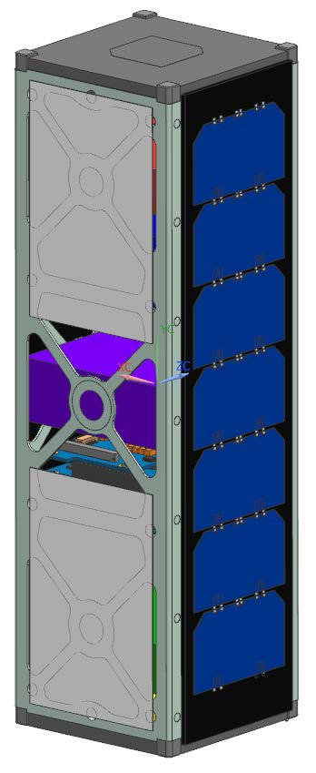
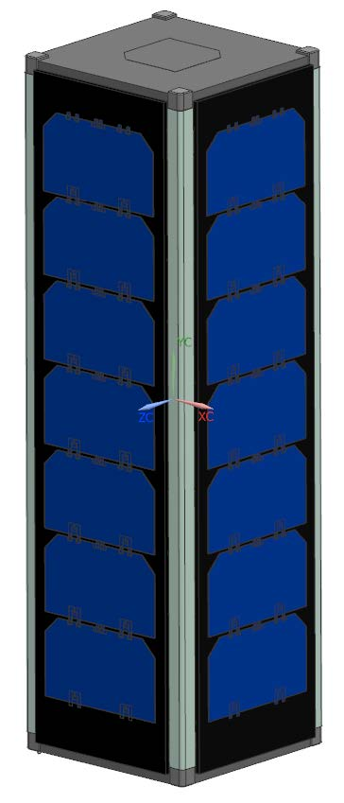
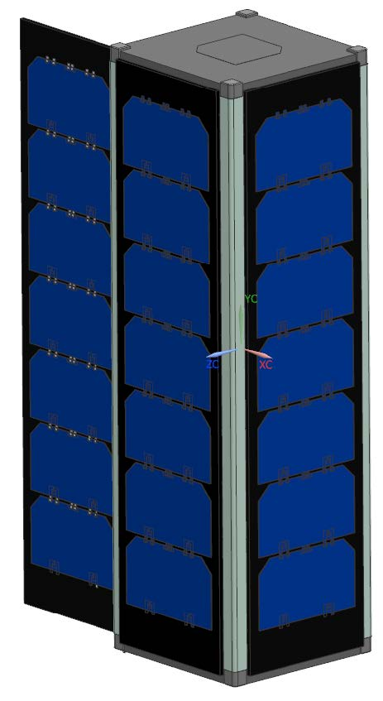
Mission Overview
Scientific Goals
  Detect and measure charged cosmic particles coming from the galactic plane.
  Test various types of Random Access Memory subjected to solar radiation over 1 year to find degradation rates
Spacecraft – 3U CubeSat
NASA CubeSat Launch Initiative
  Submit Proposal November 2017
Cost < 200k for development*
Designing for ISS orbit
  402-424 km
  51.6 degree inclination
Notes:
~7 ground station passes per day

Slide 4
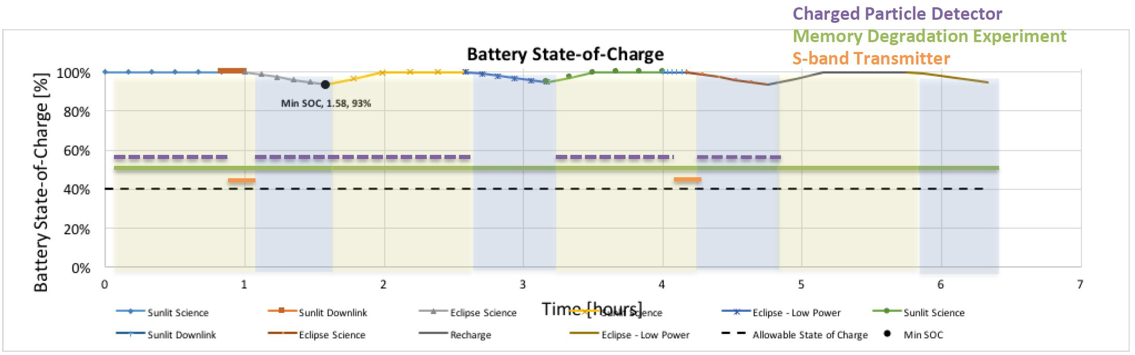
Concept of Operations
Charged Particle Detector: 50% duty cycle (10 minutes on, 10 minutes off
  Turned off during low-power and transmit events
Memory Degradation Experiment: Always running
Modes of Operation
  Science
  Downlink
  Low Power (Eclipse)
  Recharge
Notes:
Power margins will be discussed in more detail with laurens presentation

Slide 5
Purpose and Benefits
Education
  Provide real world experience not possible with regular engineering classwork
Strong, achievable scientific goals
  Work with faculty to insure the payloads will be used to obtain high value scientific data
  Payload objectives aligned with NASA’s strategic goals
Commercially available bus systems
  Allow development efforts to be focused on payloads
Work with teams, departments, and organizations both on and off campus

Slide 6
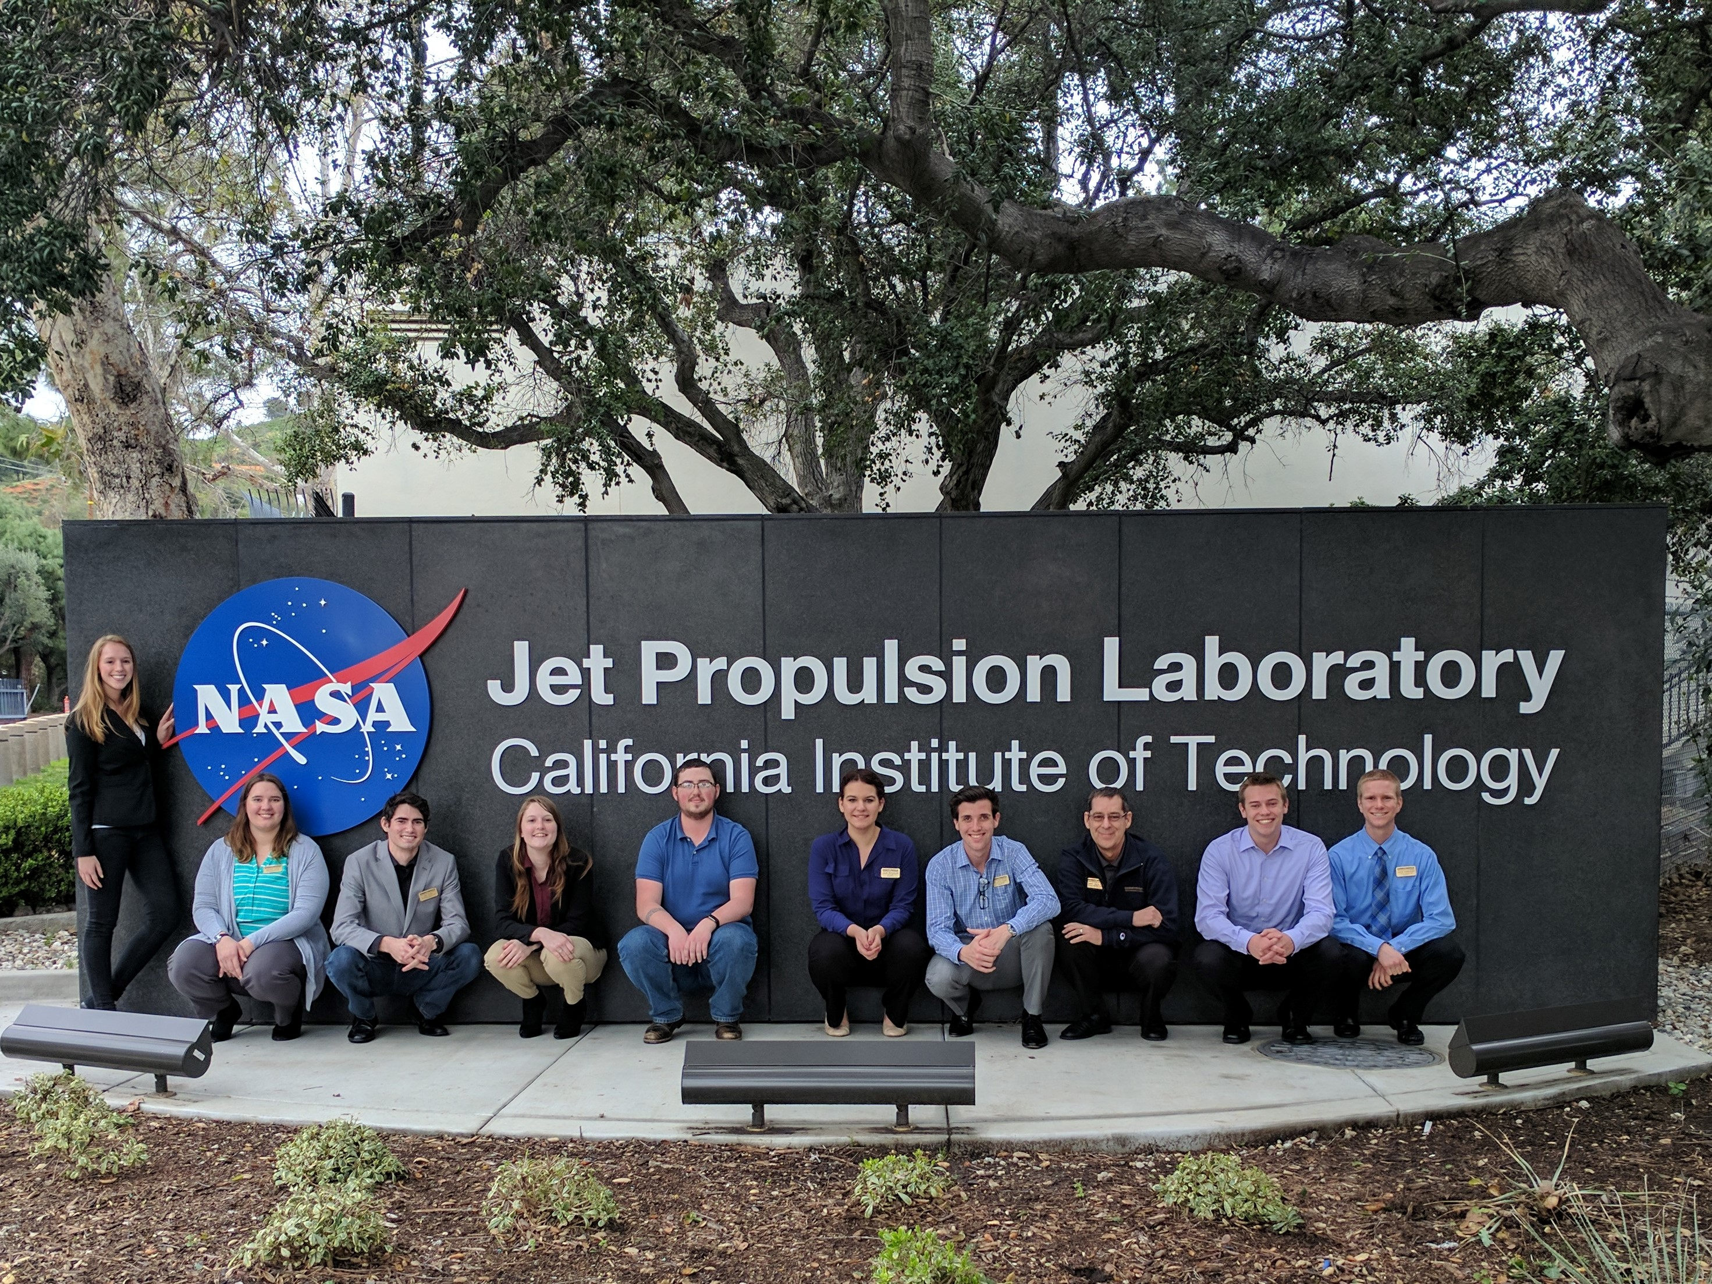
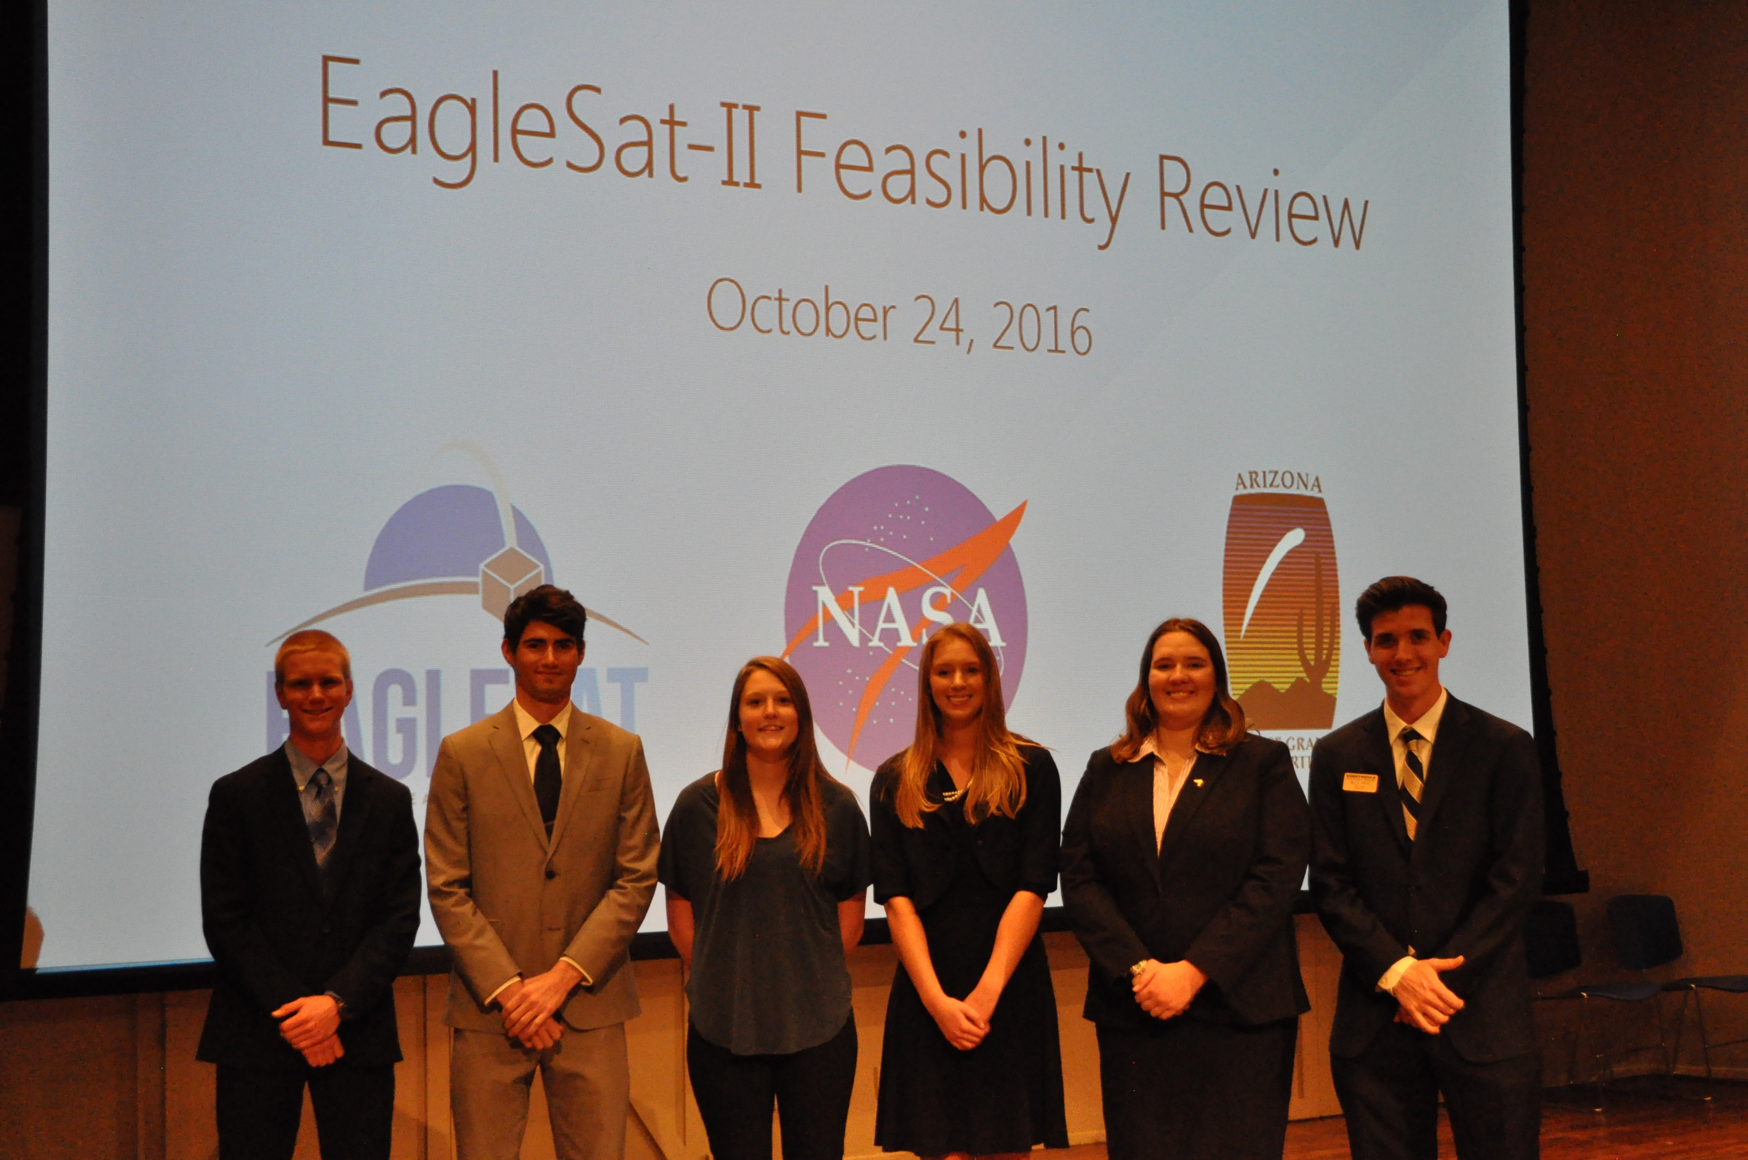
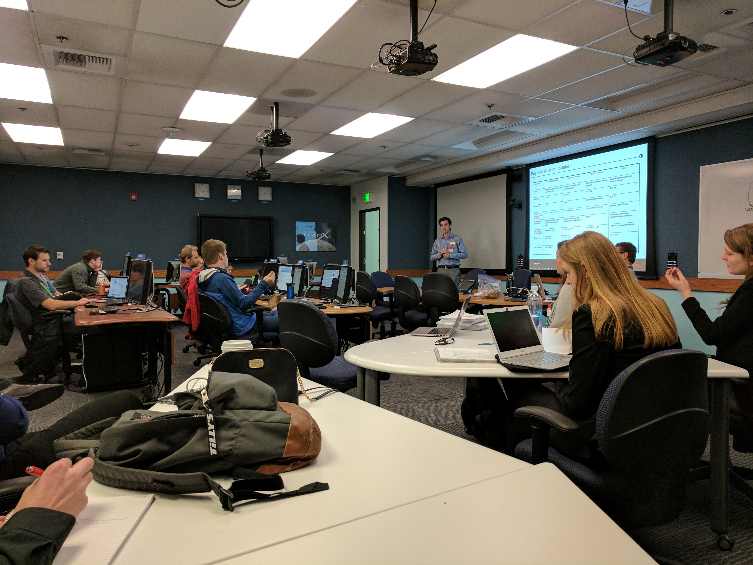
Purpose and Benefits: Cooperation
NASA’S JPL
  Held a 2 day study session with JPL’s Team Xc to work on hardware design and concept of operations
NASA’S Johnson Space Center
  Held several conference calls discussing the feasibility of space debris detection
Embry-Riddle Space Physics Department
  Cooperate in developing the charged particle detector

Slide 7
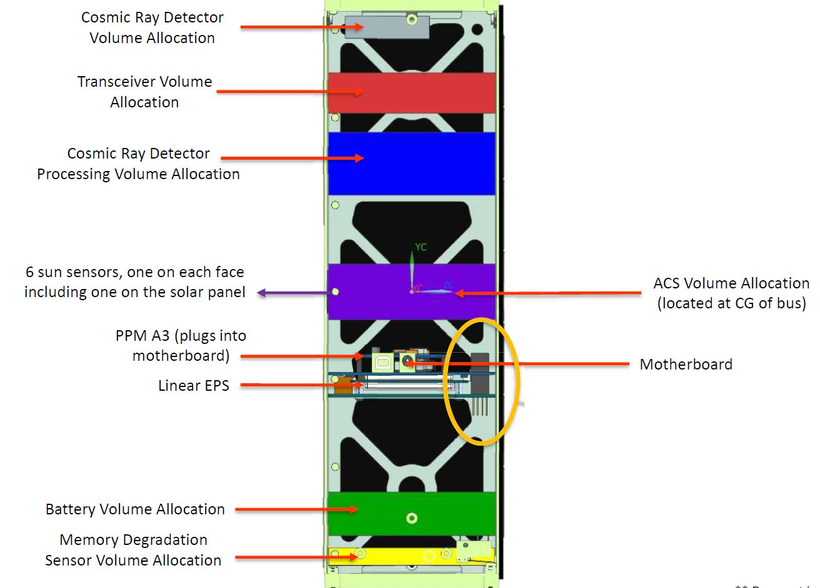
Development Progress (last 9 months)
Finalize mission concepts & scientific goals
Held a successful feasibility review with faculty
Conducted a 2 day study session With JPL’s Team-Xc to evaluate design choices.
Mission and system level requirements
Finalized concept of operations
Drafted preliminary budget

Slide 8
Development Challenges
De-scoped space debris detection experiment from the mission
  Driving requirements too high for the bus systems
  Too expensive
  Design not mature enough
Budget constraints
  Securing funding though various sources, each with their own guidelines for spending
Lack of software engineers
  Embry-Riddle has a very small software engineering program.

Slide 9
Example: Development Challenges
Tighter Pointing Requirements
Star Tracker + 3-axis reaction wheels
~100k additional cost
Parameter | Space Debris Payload
Control | +- 5 degrees
Power | 1.2 Watts
Knowledge | +- 0.5 degrees
Stability | +- 0.33 degrees/second
Data Volume per Orbit (Mb) | ~96 Mb per orbit
Tighter requirements on EPS and COMMS
More deployable solar panels required
Increased complexity and failure points

Slide 10
Cost Breakdown*
~Total: $194,000
*All costs are approximate and subject to change
**CDH and Structure are one cost because they are sold as a kit

Slide 11
Timeline – Next 9 Months
Internal Preliminary Design Review
Preliminary Design Review
NASA CSLI Proposal
11/21/2017
NASA CSLI Manifest
2017
May
Jun
Jul
Aug
Sep
Oct
Nov
Dec
2018
2018
5/15/2017 - 8/29/2017
Preliminary Design Document
Development completion projected late 2019

Slide 12
Conclusion
Development on EagleSat 2 is progressing as planned with estimated completion in 2019
Support from Arizona Space Grant helps greatly in achieving our goals
Next Milestone: preliminary design review in September, 2017
Questions / Comments: paigeh@my.erau.edu

